Slide 1

Drama At Cornwallis Academy
Year 7 – LESSON 7
Lesson Objective:
To Self Evaluate your own performance during this introduction to drama scheme of work.

Slide 2
Level | Drama Strand
 | Creating | Performing | Reflecting
Entry | I can take part in a drama activity | I can participate in part of a group performance | I can identify positive and negative aspects within my work
1 | I can take part in a range of drama activities I can explore problems in an imagined world and make up plays from stories or other stimuli | I can participate in a short group performance I show some consideration of movement and voice in performance | I can make simple connections between the dramas I experience and my own life I can recognise when my own work and the work of others’, could be improved
2 | I can perform my own simple scenes, demonstrating an understanding of drama techniques | I can use my voice and body to create a simple character I can act out improvised dramas | I can talk about why I made certain decisions in my play I can show a basic understanding of how meaning can be shown
3 | I can establish a character with control over movement and voice I can use the dialogue in existing texts as well as creating my own I can devise plays from a range of stimuli I can respond to the use of drama techniques to deepen the role or understanding of the situation e.g. hot seating I can sustain a defined character for a reasonable amount of time | I can learn lines and organise simple performances | I can give suggestions on how work could be improved I can talk about my work using some technical drama terminology I can discuss and give reasons for my preferences in the drama I have seen

Slide 3
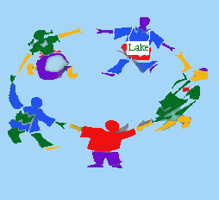
1-20
Lesson Objective:
To Self Evaluate your own performance during this introduction to drama scheme of work.
Students stand in a circle.
Students must count from 1-20.
If two students speak at the same time they must return to zero and start again.
You are not allowed to create a system, you must work together and focus.

Slide 4
SELF-EVALUATION
Lesson Objective:
To Self Evaluate your own performance during this introduction to drama scheme of work.
Fill in your self-evaluation form in your neatest handwriting.
Ask the teacher if you need any help.

Slide 5
Lesson Objective:
To Self Evaluate your own performance during this introduction to drama scheme of work.
Reflection:
What is Self Evaluation?
Why do we Evaluate?

